Slide 1
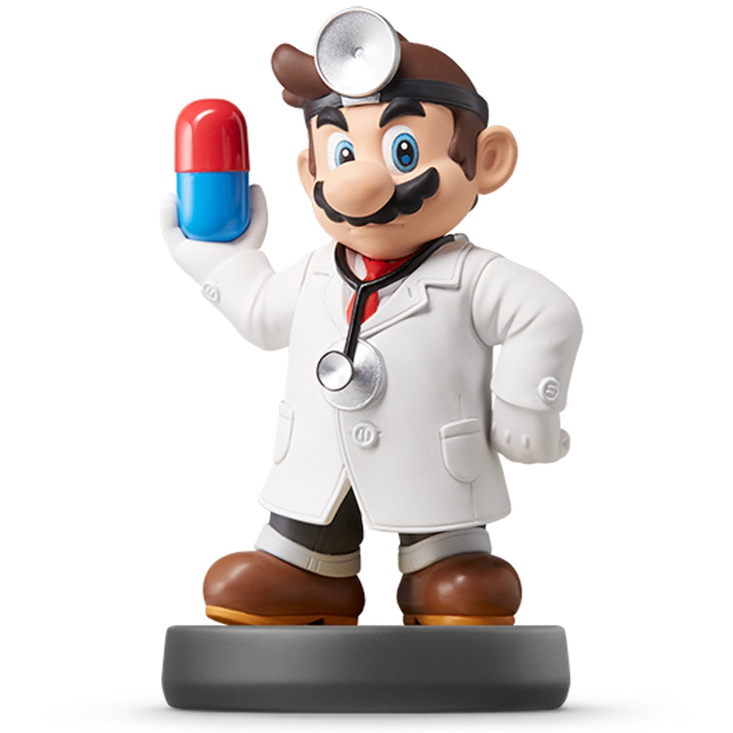
Factors

Slide 2

Introduction
Joyfully Read Chapter 12
Additional Package
Not Part of the tidyverse
For Variables with,
Fixed Set of Values
Known Set of Values
Sophisticated Character Vector
Factors Are on a
New Level
> library(forcats)

Slide 3
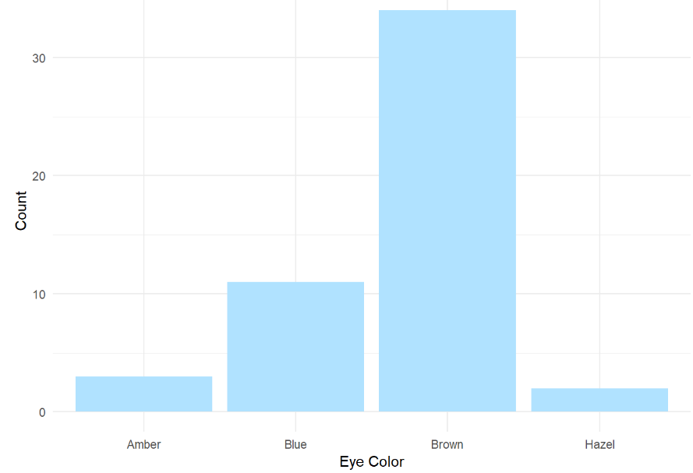
Level 1: Motivation
Eye Color Distribution
Randomly Sample 50 People
Distribution via Bar Plot
How to Make More Informative?

Slide 4
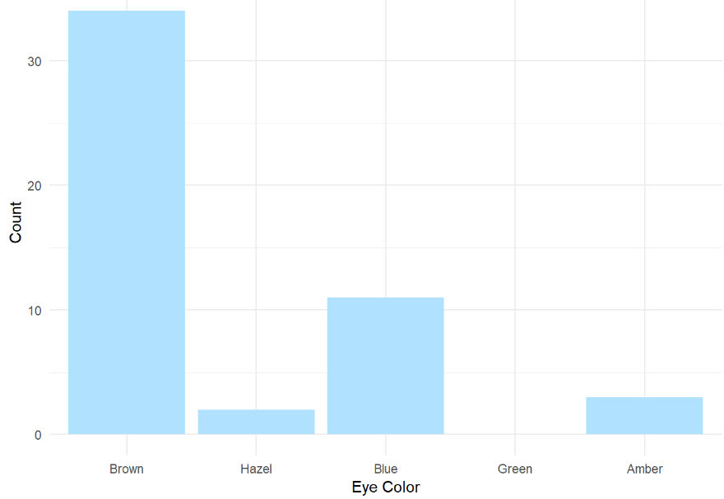
Level 1: Motivation
Eye Color Distribution (Cont.)
Display Eye Colors Absent From Sample

Slide 5
Level 1: Motivation
Survey Results
How Would You Describe
Dr. Mario’s Teaching?
Magical
Alright
Regular
Inferior
Offensive
Class of 80 Students Answer End-of-the-Year Survey.

Slide 6
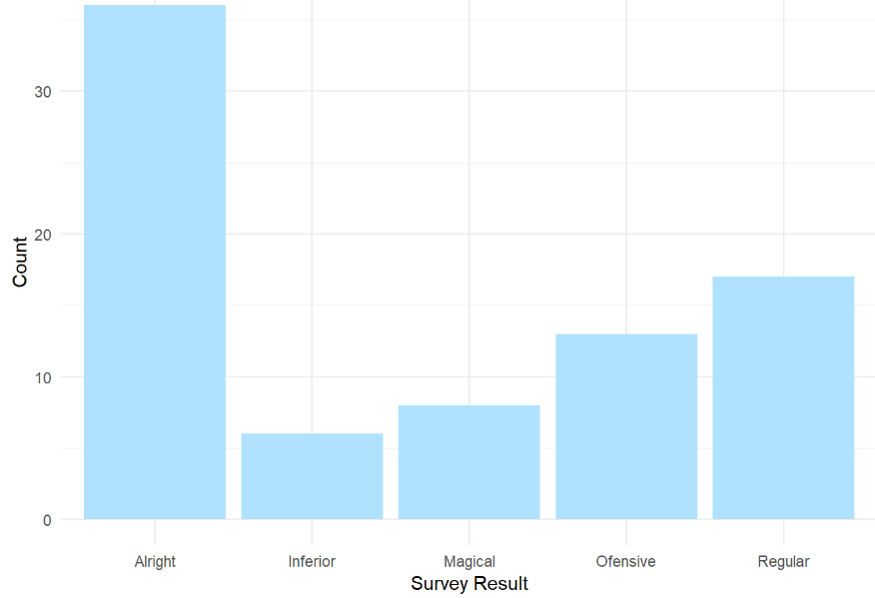
Level 1: Motivation
Survey Results (Cont.)
Distribution of Results
What is Wrong?

Slide 7
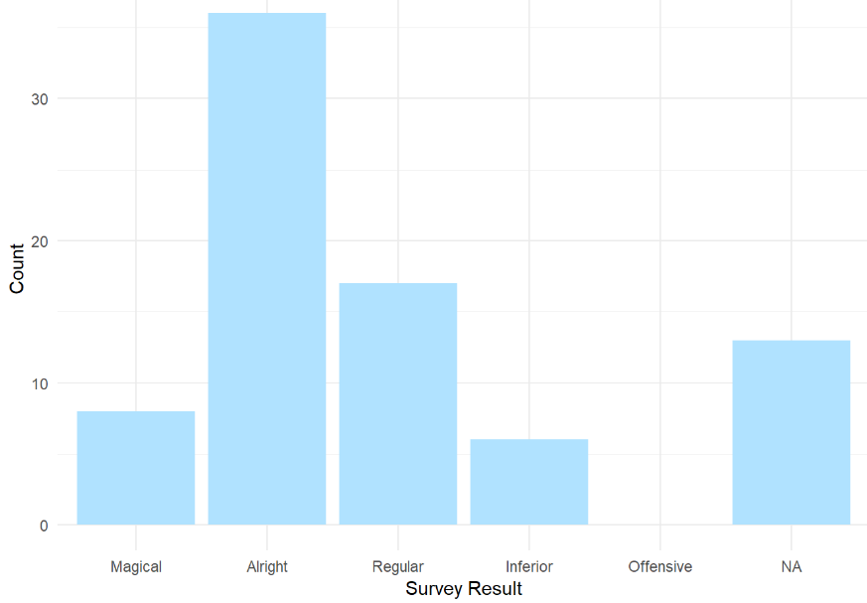
Level 1: Motivation
Survey Results (Cont.)
Misspelling “Offensive” is Offensive
Ordinal Categorical Variable

Slide 8
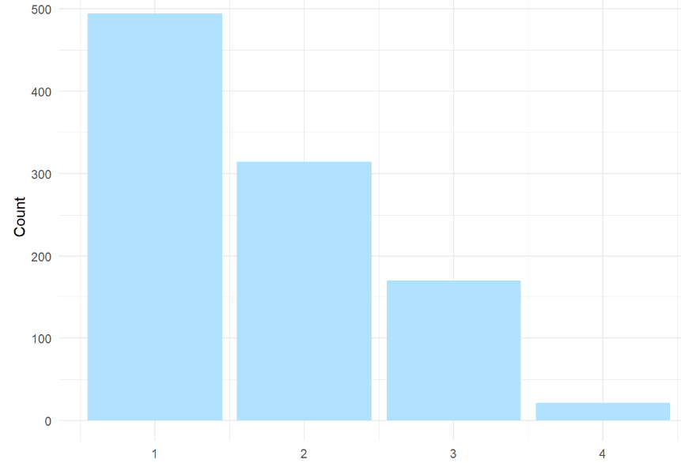
Level 1: Motivation
Urbanicity
Classification {1,2,3,4}
Sample 1000 Households and Record Their Urbanicity
What Would Make this Better?

Slide 9

Level 1: Motivation
Urbanicity
Data Dictionary
1 = Metropolitan
2 = Burbs
3 = Rural
4 = Isolated

Slide 10
Level 2: General Social Survey
Data Contained

Slide 11
Closing
Disperse and Make Reasonable Decisions

